Slide 1
ASSIGNMENT 2 Q.1
YUVRAJ 201170

Slide 2
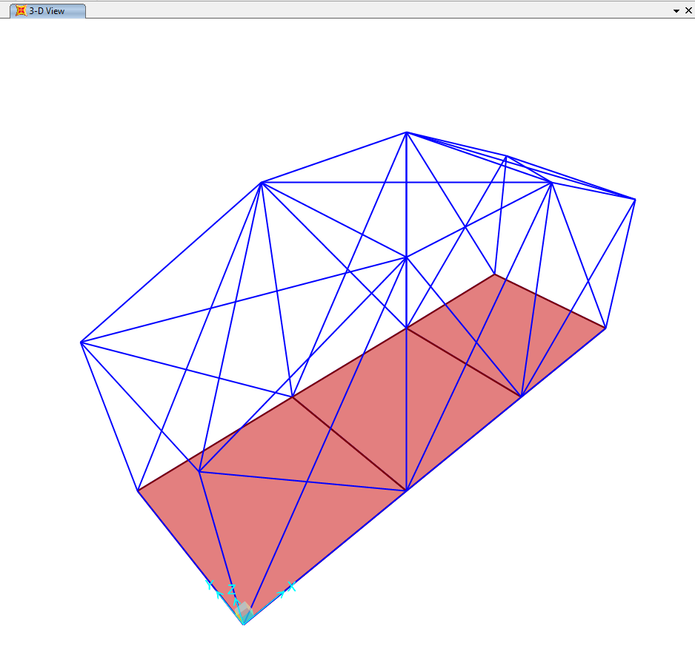
UNDEFORMED
3D

Slide 3
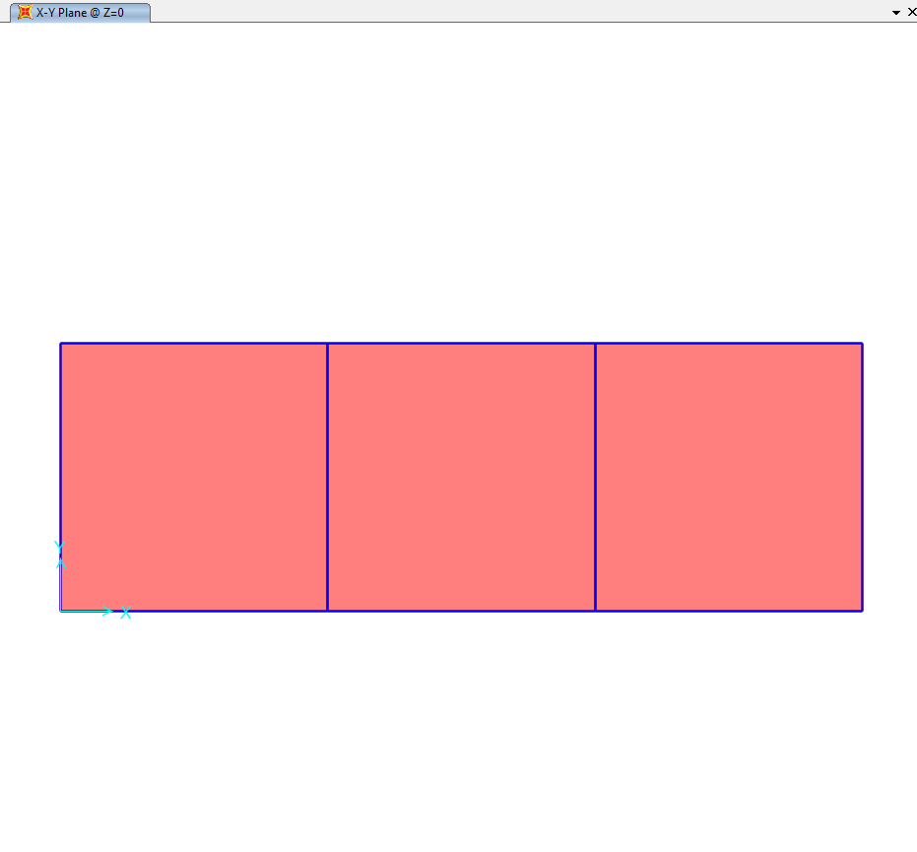
UNDEFORMED
XY

Slide 4
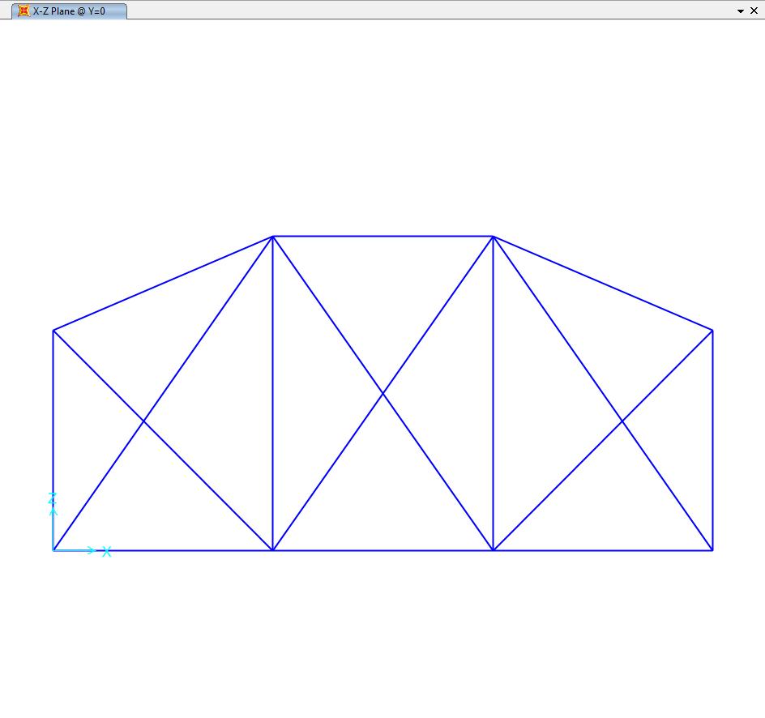
UNDEFORMED
XZ

Slide 5
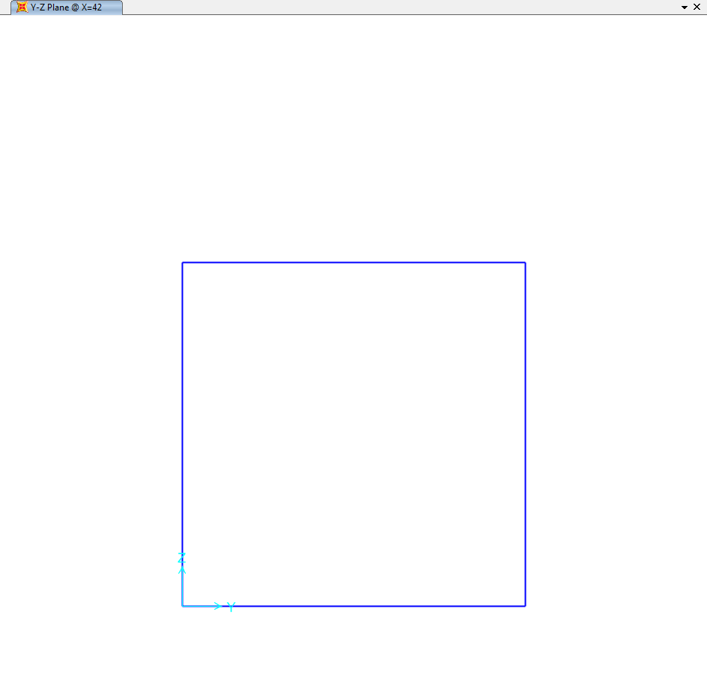
UNDEFORMED
YZ

Slide 6
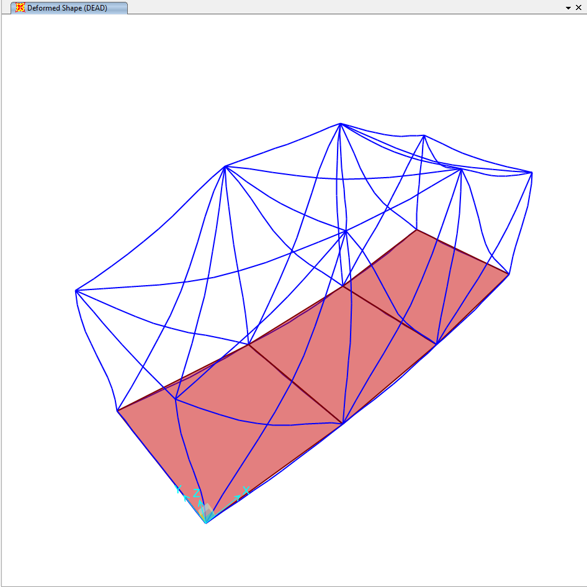
DEFORMED
3D

Slide 7
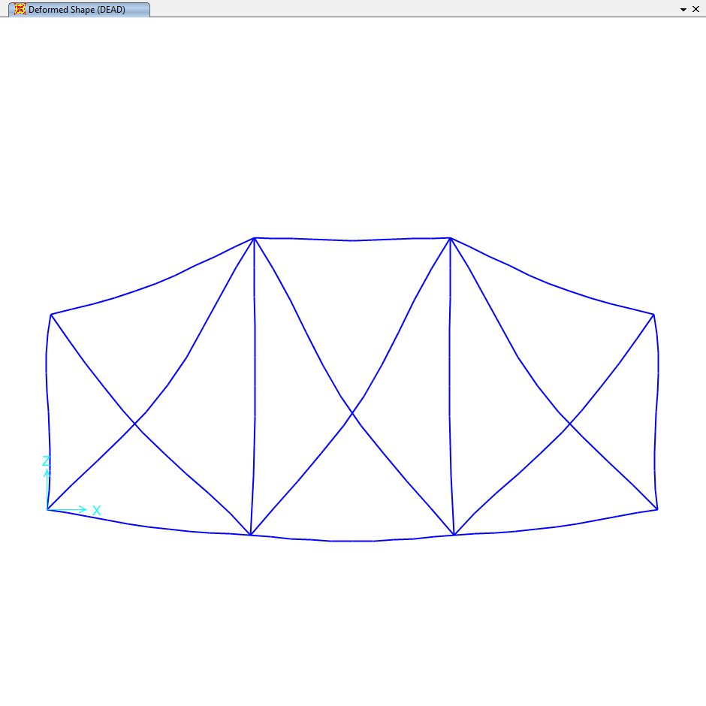
DEFORMED
XZ

Slide 8
Value Of a = 7 Roll number = 201170

Slide 9
ASSIGNMENT 2 Q.2

Slide 10
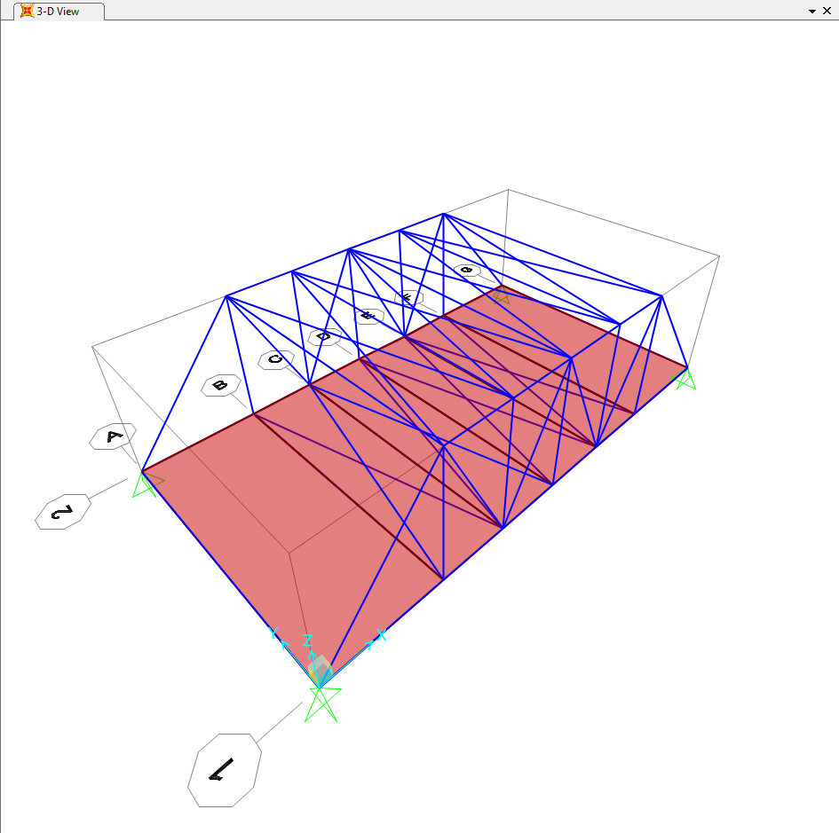
UNDEFORMED
3D

Slide 11
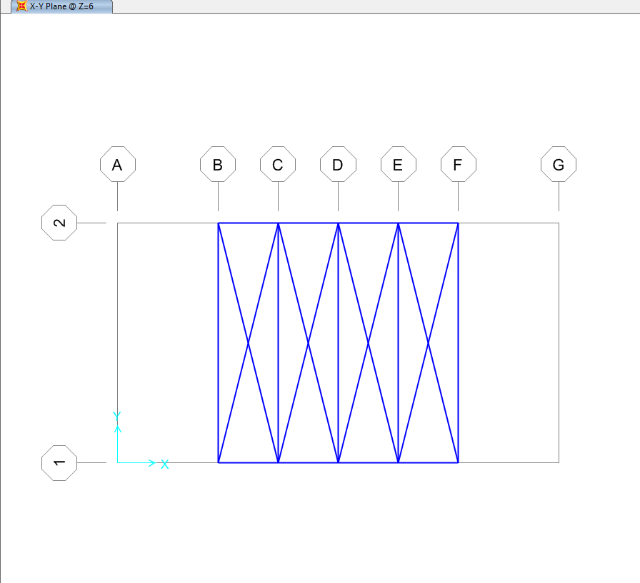
UNDEFORMED
XY

Slide 12
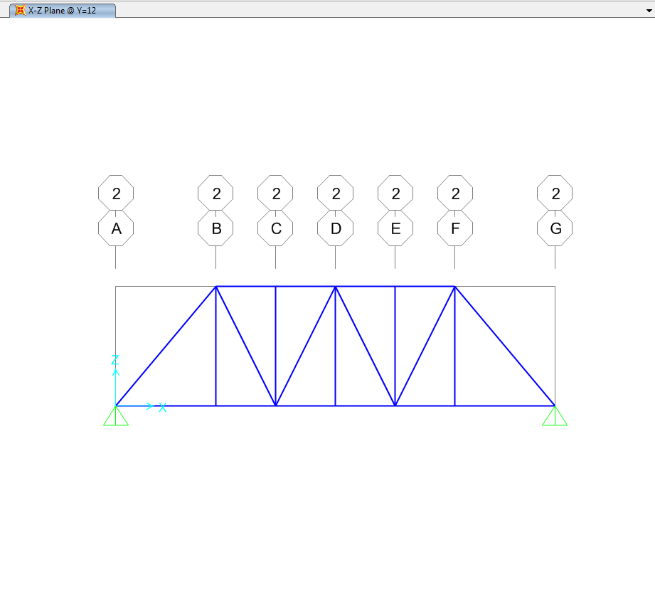
UNDEFORMED
XZ

Slide 13
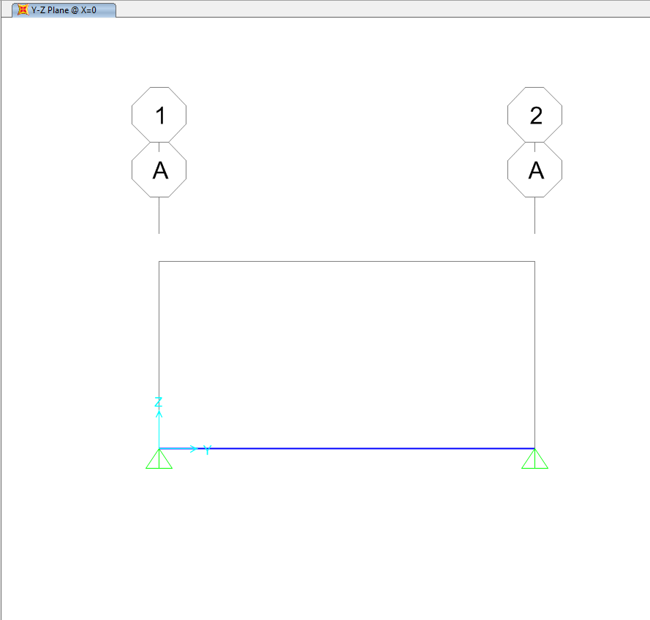
UNDEFORMED
YZ

Slide 14
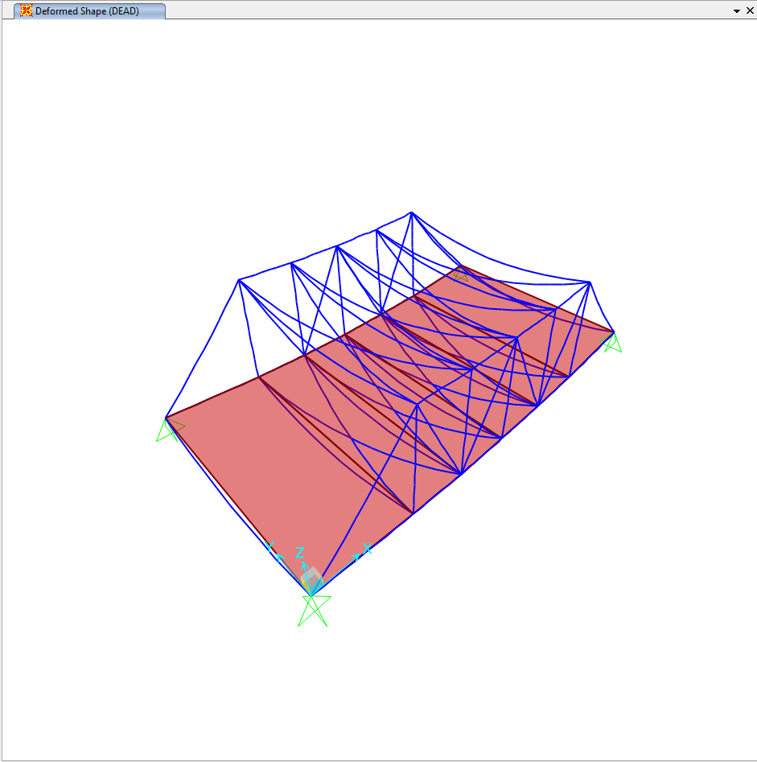
DEFORMED
3D

Slide 15
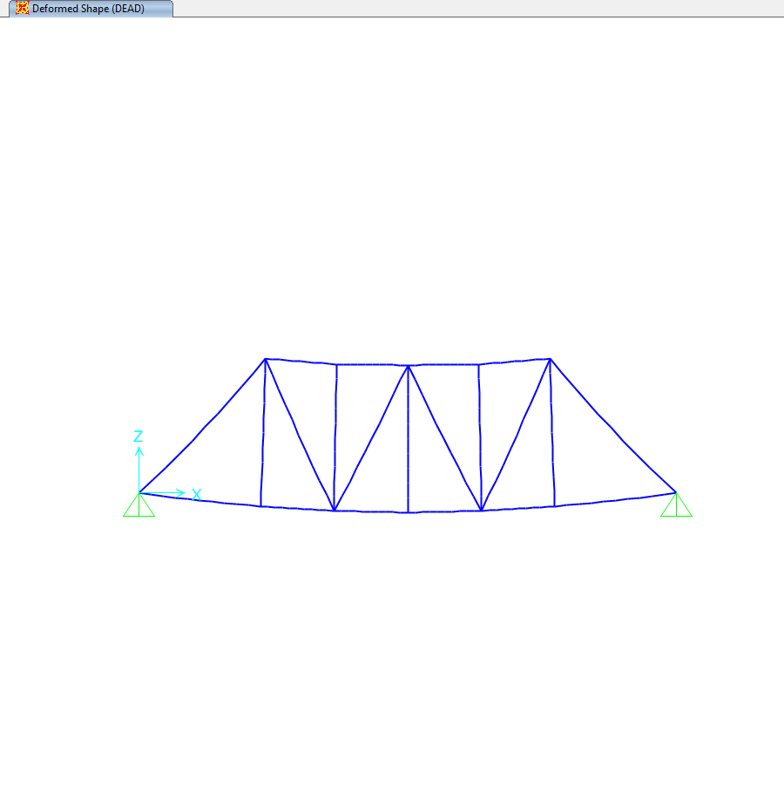
DEFORMED
XZ

Slide 16
Value of a = 0 Roll number = 201170
To increase the stability , some extra members have been added at outer edges.

